Slide 1

CS 533 INTRO TO DATA SCIENCE
Michael Ekstrand

Slide 2
TIME SERIES

Slide 3

Learning Outcomes
Summarize and plot time series data with Pandas
Understand that time series data is often not independent
Photo by Bruno Figueiredo on Unsplash

Slide 4
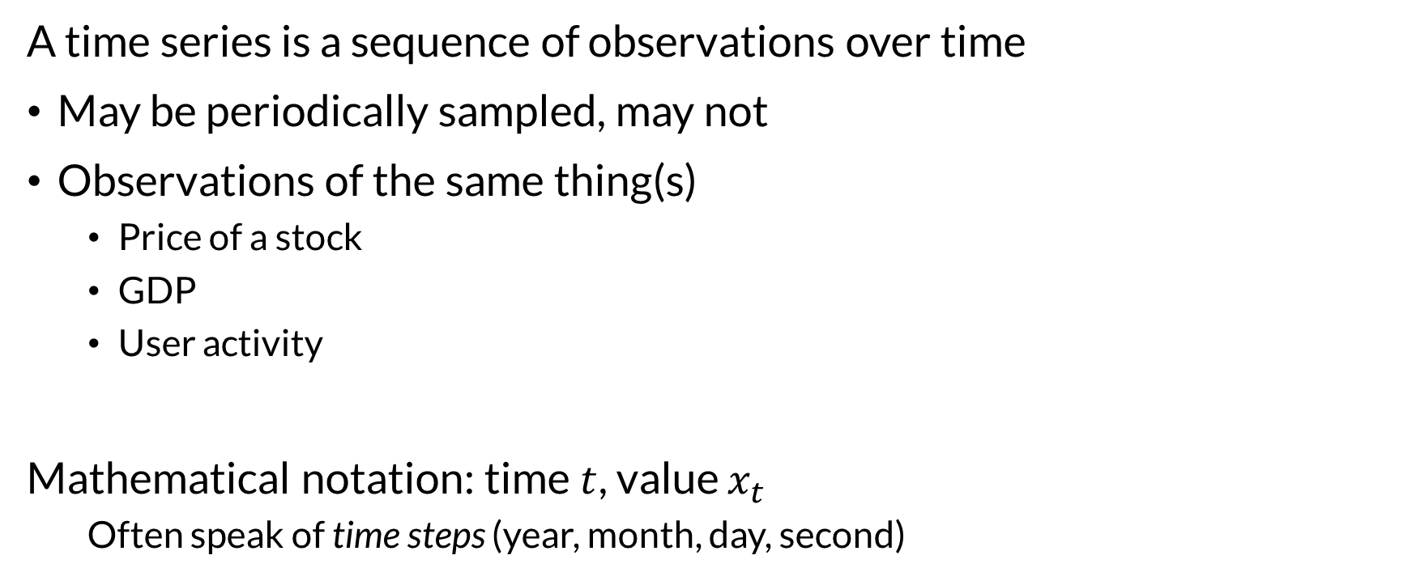
Time Series
A time series is a sequence of observations over time
May be periodically sampled, may not
Observations of the same thing(s)
Price of a stock
GDP
User activity
Mathematical notation: time $t$, value $x_{t}$
Often speak of time steps (year, month, day, second)

Slide 5
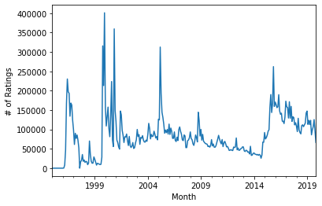
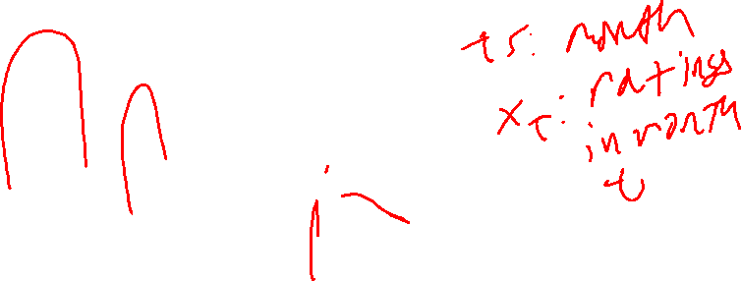
Time Series

Slide 6
Time Representation
Many representations:
String dates
Years & months
Timestamps (seconds, ms, etc.)
Pandas: must convert to a datetime
pd.to_datetime

Slide 7
Pandas Setup Steps
Create/convert datetime column with instance times
Index data frame by timestamp
Sort index
ratings['timestamp'] = pd.to_datetime(ratings['timestamp'], unit='s') rts = ratings.set_index('timestamp').sort_index()
Time series exception to “prefer unique indexes” guideline

Slide 8
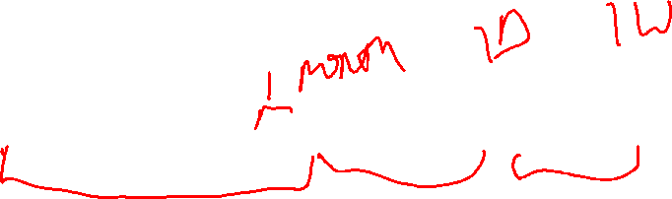
Operation: Resampling
Like groupby, but on time intervals
Compute aggregate functions for time intervals
‘on’ option allows a non-index column
monthly_ratings = rts.resample('1M')['rating'].count()

Slide 9
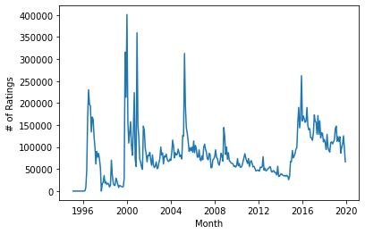
Operation: Plotting
Matplotlib & Seaborn render timestamp X axes well
sns.lineplot(data=monthly_ratings)

Slide 10
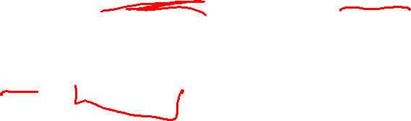
Operation: Range Select
Time series indexes support range operations
Select by range: rts.loc['2010-01-01':'2010-12-31']
Includes end point (unlike normal slice!)
Select by period: rts.loc['2010-07']

Slide 11
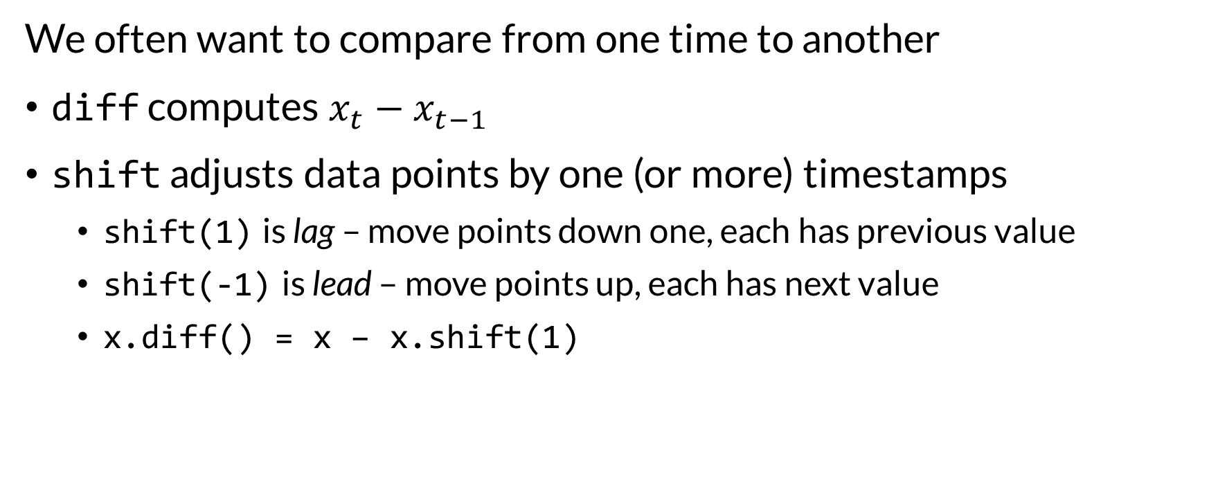
Operation: Diff and Shift
We often want to compare from one time to another
diff computes $x_{t}−x_{t−1}$
shift adjusts data points by one (or more) timestamps
shift(1) is lag – move points down one, each has previous value
shift(-1) is lead – move points up, each has next value
x.diff() = x – x.shift(1)

Slide 12
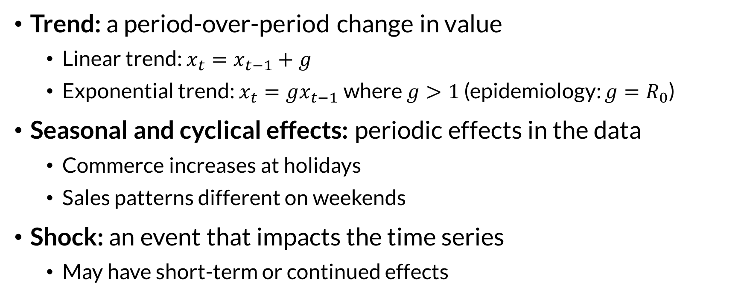
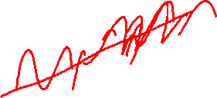
Time Effects
Trend: a period-over-period change in value
Linear trend: $x_{t}=x_{t−1}+g$
Exponential trend: $x_{t}=gx_{t−1}$ where $g>1$ (epidemiology: $g=R_{0}$)
Seasonal and cyclical effects: periodic effects in the data
Commerce increases at holidays
Sales patterns different on weekends
Shock: an event that impacts the time series
May have short-term or continued effects

Slide 13
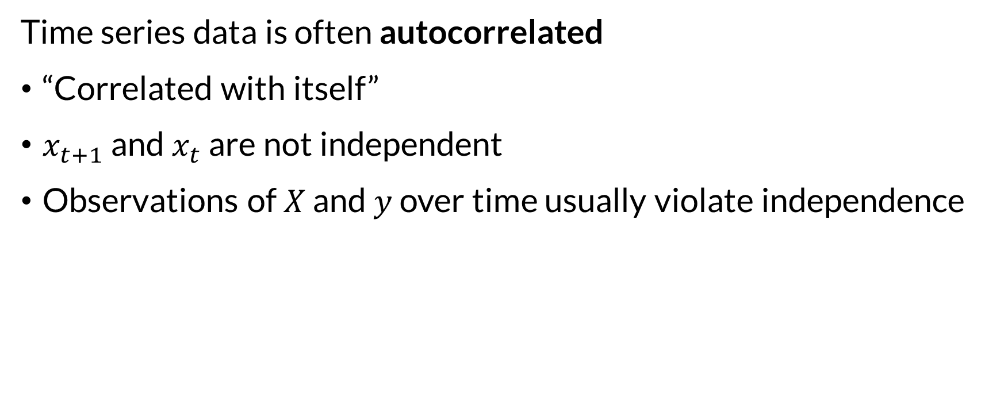
Autocorrelation
Time series data is often autocorrelated
“Correlated with itself”
$x_{t+1}$ and $x_{t}$ are not independent
Observations of $X$ and $y$ over time usually violate independence

Slide 14

Wrapping Up
Repeated data over time requires particular handling and has distinct operations.
Pandas provides these through datetime columns and indexes.
Photo by Javier Esteban on Unsplash

